Slide 1

KALERWE
S.D.A Hymnal
4 ~ Verses
127.
Bwe Nfuna Eddembe Mu Bulamu Bwange.…
~
When Peace Like a River…

Slide 2
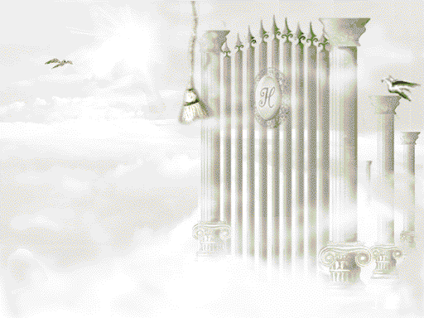
1 of 4 verses
Bwe nfun(a) eddembe
Mu bulamu bwange,
Oba bwe mbeera mu nnaku.
Onjigirize okukkirizanga,
Buli mbeera yonna mw’ontadde.
Chorus:
Mirembe, mirembe;
Mukama njagala mirembe.

Slide 3

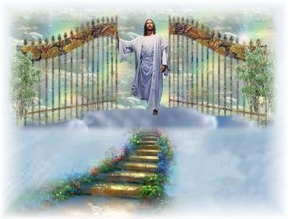
2 of 4 verses
Setani bw’aleeta
ebikemo bye,
Yimusa essuubi lyange,
Nti Yesu alab(a)
obunafu bwange,
Era Ye atambula nange.
Chorus:
Mirembe, mirembe;
Mukama njagala mirembe.

Slide 4
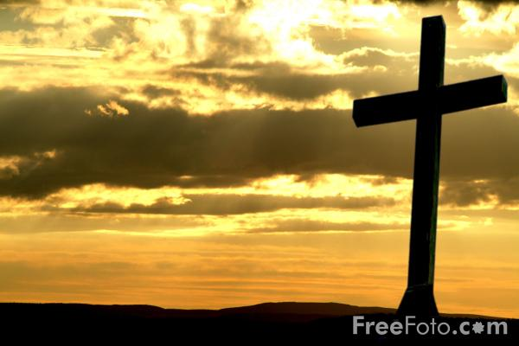
3 of 4 verses
(E)kigambo kino
Kyokka kye nesiga,
Nti ebibi byange byonna,
Byakomererwa ku
musalaba gwe,
Mukama Yesu yebazibwe.
Chorus:
Mirembe, mirembe;
Mukama njagala mirembe.

Slide 5
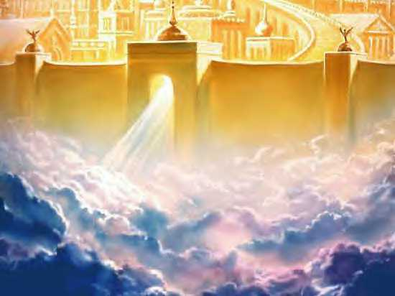
4 of 4 verses
Mukama ayanguye olunaku,
Olulibikkula byonna;
(E)ssubi liritukirira bw’alijja,
Ndimulaba Yesu n’amaaso.
Chorus:
Mirembe, mirembe;
Mukama njagala mirembe.

